Slide 1
Fundamental of Marketing
Unit 1 ( Introduction)

Slide 2

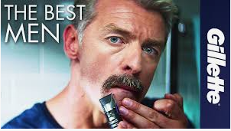
Did short film go wrong?
The razor company's short film, called Believe, plays on their famous slogan "The best a man can get”. What controversy you have though?
https://youtu.be/UYaY2Kb_PKI

Slide 3


As part of the public, are we being too sensitive? Would you like your son, daughter, sister brother, nephew or niece seeing this ad?
https://youtu.be/tI4ap-lMOoc

Slide 4
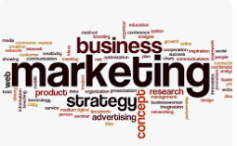
Meaning of Marketing
Marketing is the process of promoting, selling, and distributing products or services to customers. It involves understanding consumer needs and preferences, creating products or services that satisfy those needs, and communicating their value effectively to the target audience. Marketing encompasses a range of activities such as market research, product development, pricing, advertising, branding, and sales. Its ultimate goals is to generate revenue by attracting and retaining customers while also building brand loyalty and awareness.

Slide 5
Definitions
Dr. Philip Kotler defines marketing as “the science and art of exploring, creating, and delivering value to satisfy the needs of a target market at a profit. Marketing identifies unfulfilled needs and desires. It defines, measures and quantifies the size of the identified market and the profit potential. It pinpoints which segments the company is capable of serving best and it designs and promotes the appropriate products and services.”
Marketing is “not only much broader than selling; it is not a specialized activity at all. It encompasses the entire business. It is the whole business seen from the point of view of the final result, that is, from the customer’s point of view. Concern and responsibility for marketing must therefore permeate all areas of the enterprise.” Peter Drucker.

Slide 6
Marketing can be defined as the set of activities, processes, and strategies aimed at promoting, communicating, and delivering value to customers in order to satisfy their needs and wants, ultimately leading to the exchange of goods or services and creating long-term relationships between businesses and customers. It involves understanding consumer behavior, identifying target markets, developing products or services that meet consumer needs, pricing them appropriately, promoting them through various channels, and distributing them effectively to reach and engage the target audience.

Slide 7
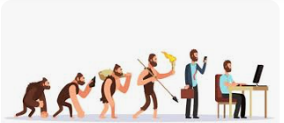
Evolution of Marketing Philosophies
The evolution of marketing philosophies reflects changing attitudes towards how businesses should interact with their customers and markets. These philosophies have evolved over time to adapt to shifts in consumer behavior, technological advancements, and societal values. Here's a brief overview of the key marketing philosophies.
There are several forces that has helped modern concept of marketing to develop.
Decline of company sales
Slow growth of company
Changing buying patterns of the customer
Increasing competition
Increasing sales expenditure

Slide 8
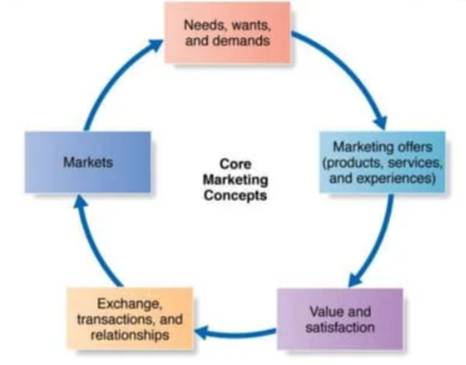
Core Concept of Marketing
The Production Concept
The Product Concept
The Selling Concept
The Marketing Concept
The Morden Marketing Concept
The Societal Marketing Concept
The Holistic Marketing Concept

Slide 9
The Production Concept: The production concept is one of the earliest marketing concepts where the company focuses on the efficiency of its production processes. It is to produce the products cheaper to make it available to the mass population. The focus of the production concept is on the quantity, not the quality of the products. This philosophy assumes that consumers prioritize products that are widely available and affordable. Key characteristics of the production concept includes:
Efficiency in production
High Production Volume
Mass Distribution
Minimal Product Variation
Limited Marketing and Innovation
Examples: Coca-Cola, Ford Motors, Mc-Donald’s etc.

Slide 10
The Product Concept: The product concept in marketing revolves around the idea that consumers will favor products that offer the most in terms of quality, performance, and innovative features. This concept assumes that consumers are primarily interested in the intrinsic qualities of a product and will actively seek out and purchase products that offer superior benefits. Key characteristics of the product concept include:
Focus on product quality
Continuous product improvement
Innovative design
Brand reputation
Limited marketing and promotions
Example: Apple, Tesla, Dyson etc.

Slide 11
The Selling Concept: The selling concept in marketing revolves around the idea that consumers will not buy enough of a company's products unless it undertakes a significant promotional effort or selling push. This concept is typically employed for products that consumers either do not naturally seek out or do not know exist. Key characteristics of the selling concept include:
Aggressive promotion and selling
Focus on sales transaction
Short term orientation
High pressure sale tactics
Product centric approach
Examples: Time share industry, Door to door sales, Used car sales, Times of economic downturn

Slide 12
The Marketing Concept: The marketing concept is a business philosophy that centers around identifying and satisfying the needs and wants of customers. It emphasizes understanding customer needs and preferences, creating value-driven products or services, and building long-term relationships with customers to achieve organizational goals. Key principles of the marketing concept include:
Customer orientation
Integrated marketing efforts
Customer satisfaction
Example: Amazon, Nike, Starbucks etc.
Nike designs products tailored to the needs and preferences of athletes and fitness enthusiasts. Nike's marketing efforts encompass traditional advertising, digital marketing, sponsorships, and experiential marketing initiatives. Nike fosters community engagement through social media, events, and digital platforms, encouraging consumers to share their experiences, connect with like-minded individuals, and participate in brand-sponsored activities. By fostering brand loyalty and emotional connections, Nike maintains a strong competitive advantage in the sportswear market.

Slide 13
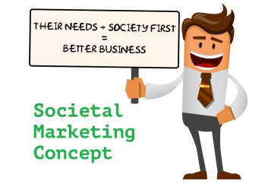
The Societal Marketing
The Societal Marketing Concept puts Human welfare on top before profits and satisfying the wants.

Slide 14
The Societal Marketing Concept: The societal marketing concept extends beyond meeting customer needs and wants to also consider the broader societal impact of business activities. It emphasizes that companies should not only focus on profitability but also consider the well-being of society. This approach advocates for businesses to adopt sustainable practices, promote social responsibility, and address societal issues through their products, services, and operations. Key principle:
Long term societal welfare
Customer and public interest
Ethical and responsible behavior
Value creation for society
Example: Patagonia, Tom shoes (TOMS Shoes demonstrates how businesses can integrate social responsibility and giving initiatives into their core business model, leveraging consumer purchases to create positive societal impact and drive meaningful change.)

Slide 15
The Holistic Marketing: Holistic marketing is an approach that considers the entire business and its environment as interconnected parts that work together to create value for customers. It encompasses all aspects of marketing, including internal marketing (ensuring employees understand and embrace the company's mission), integrated marketing (coordinating marketing efforts across various channels), and relationship marketing (building long-term relationships with customers, suppliers, and other stakeholders). The goal of holistic marketing is to create a seamless and integrated experience for customers, aligning all aspects of the business to deliver value and meet their needs effectively. The key principles of holistic approaches can vary depending on the context, but they generally involve:
Interconnectedness
System thinking
Wholeness
Context sensitivity
Balance and harmony
Example: Ikea, The whole food market, Outdoor Voices etc.

Slide 16

Thank you

